Slide 1

Mobile Ad Hoc Networks (MANETs)
TICT3243 - Mobile Computing
Group 04

Slide 2
Introduction to Ad Hoc Networks
Definition
Self-configuring, infrastructure-less wireless network
Communication
Nodes communicate directly without fixed infrastructure
Examples
Military networks, disaster recovery, IoT

Slide 3

Characteristics of MANETs
1
Bandwidth Constrained , Variable Capacity Links
2
Dynamic Topology
3
Lack Of Fixed Infrastructure
4
Energy Constrain Operations

Slide 4





Applications of MANETs
Military
Disaster Recovery
Transportation
Battlefield networks
Vehicle communication
Emergency response
Healthcare
Remote monitoring

Slide 5





MANET Design Issues
Routing Challenges
Dynamic topology impacts routing
Scalability
Large networks slow performance
Bandwidth
Wireless medium has limits
Energy
Battery-powered devices

Slide 6
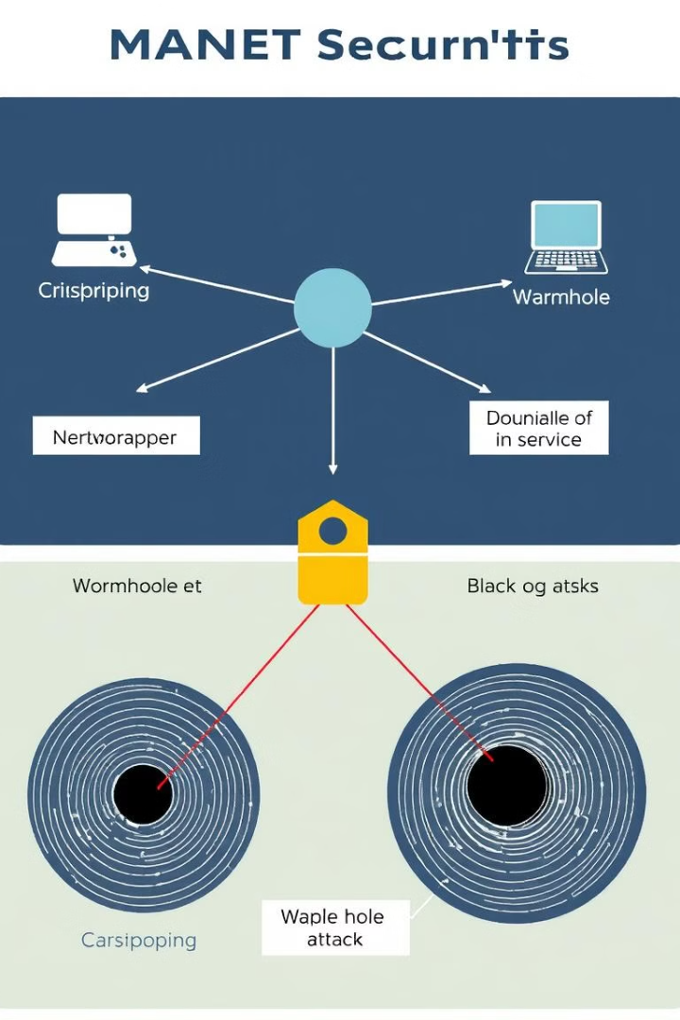
Security Threats in MANETs
Eavesdropping
Unauthorized data interception
Denial of Service
Attackers flood network with requests
Wormhole Attack
Malicious nodes create shortcuts
Black Hole Attack
Nodes drop packets

Slide 7



Routing Protocols
Reactive
2
Finds routes when needed
Proactive
1
Constantly updates routes
Hybrid
3
Mix of both approaches

Slide 8

Security Solutions
1
Encryption
Protect data transmission
2
Intrusion Detection
Detect malicious activity
3
Trust-Based Systems
Nodes maintain trust score
4
Secure Routing
Enhanced versions

Slide 9

Advantages & Challenges
Advantages
Quick deployment
Scalability
Supports mobility
Challenges
Security risks
Routing complexity
Power constraints

Slide 10

Conclusion & Future Trends
AI-driven
Self-optimization
5G Integration
Better connectivity
Blockchain
Decentralized security

Slide 11


